Slide 1
RFID Based Vehicle Tracking Industries
Stallion Systems & Solution Pvt Ltd
Sales@stallionindia.com

Slide 2
  Stallion Offer solutions
RFID Solution
Mining Solution
Parking Management
Visitor tracking
File Tracking System
Work in Progress
Student tracking
Laptop Tracking
Asset Tracking
Supply Chain system

Slide 3
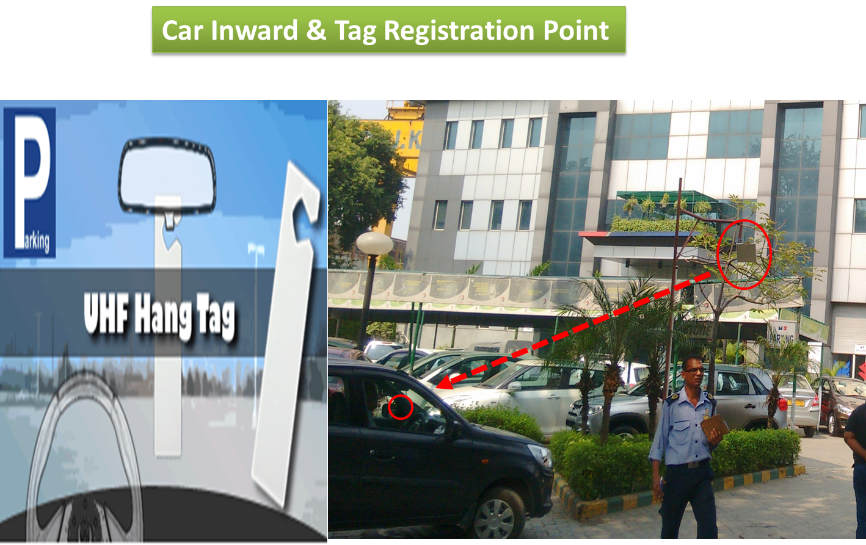
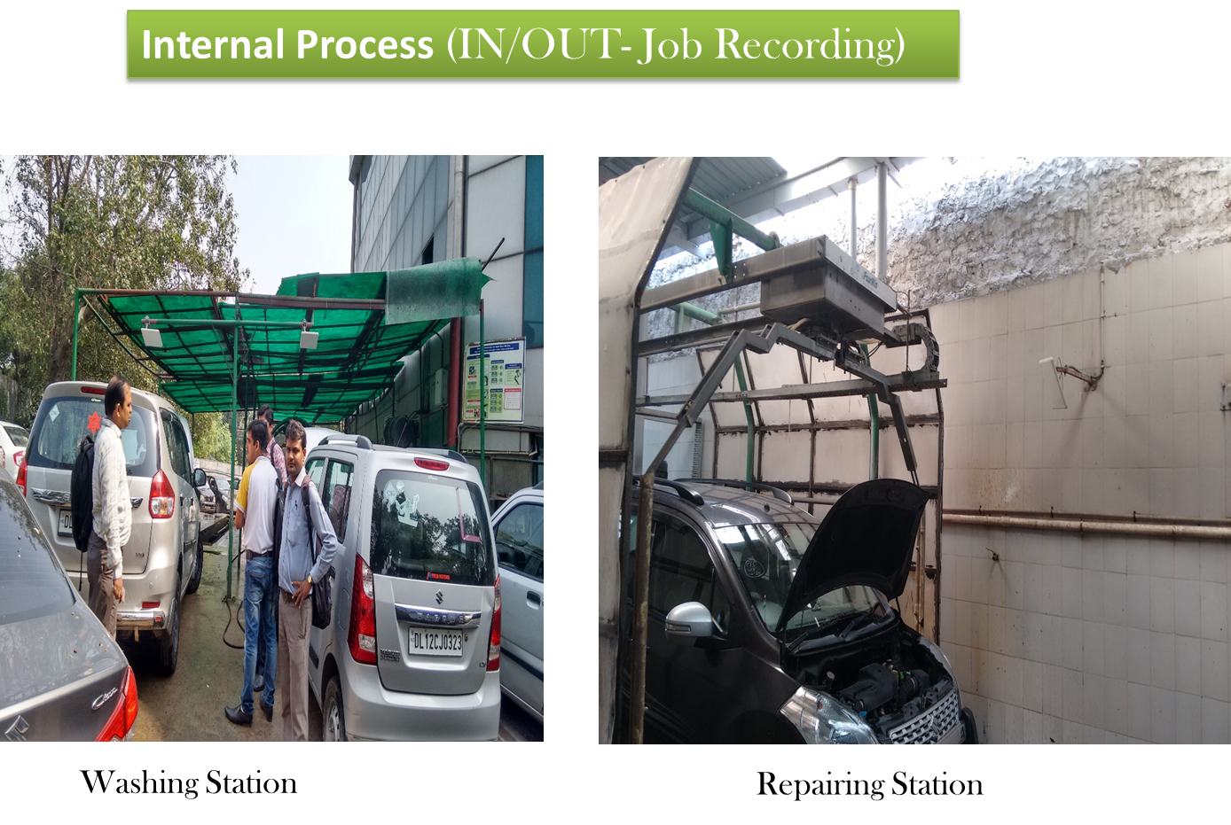
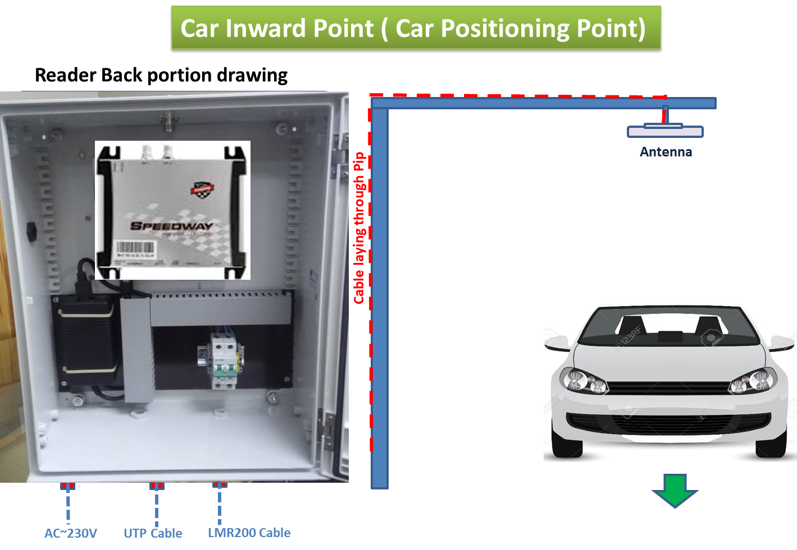
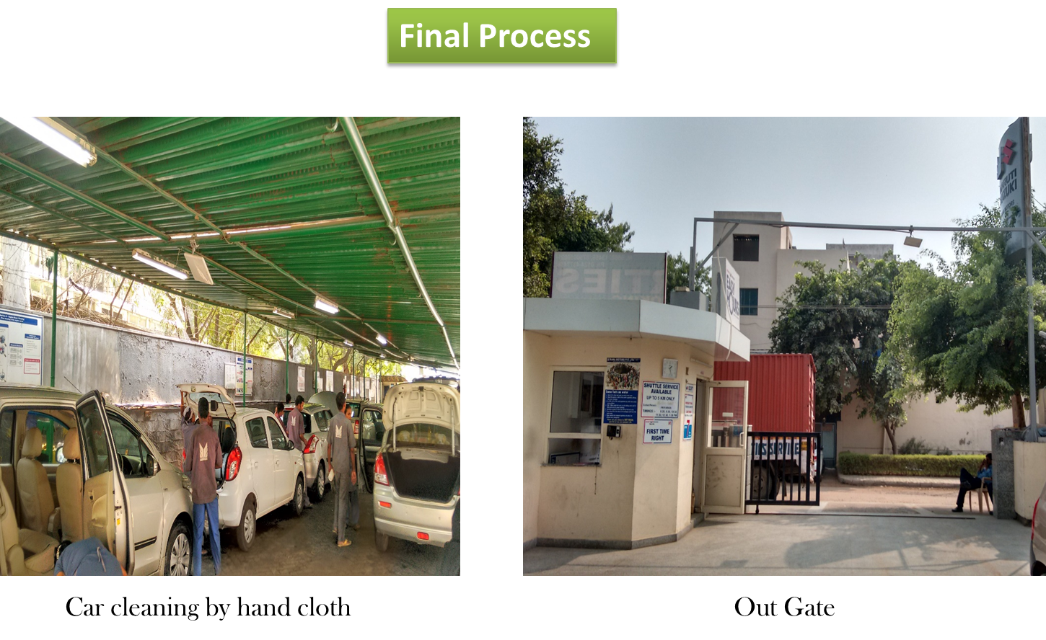
VECHICLE TURN AROUND TIME MONITORING

Slide 4
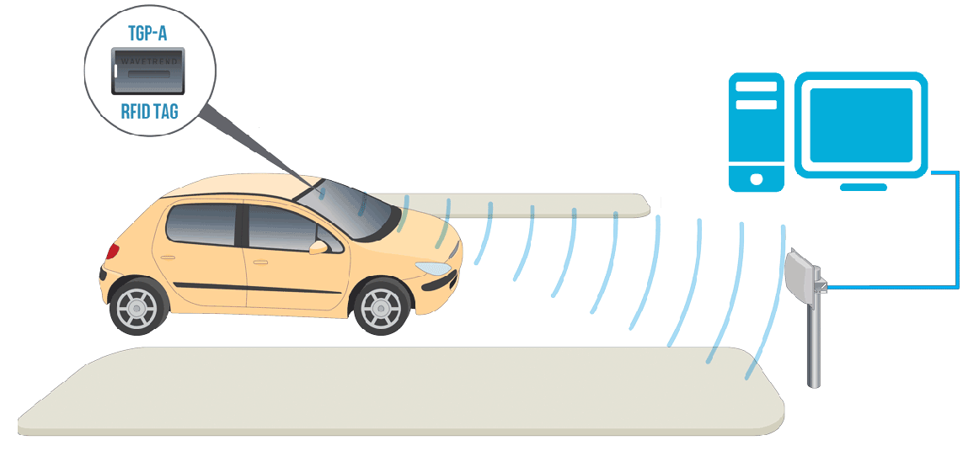
VECHICLE TURN AROUND TIME MONITORING
All work stations to be covered with RFID Readers to read the tag and identify the vehicle
Data recorded in a software application
Arrival & Departure time will be Recorded Respectively
Notification in case of any Abnormal behavior
Reports can be generated respectively

Slide 5
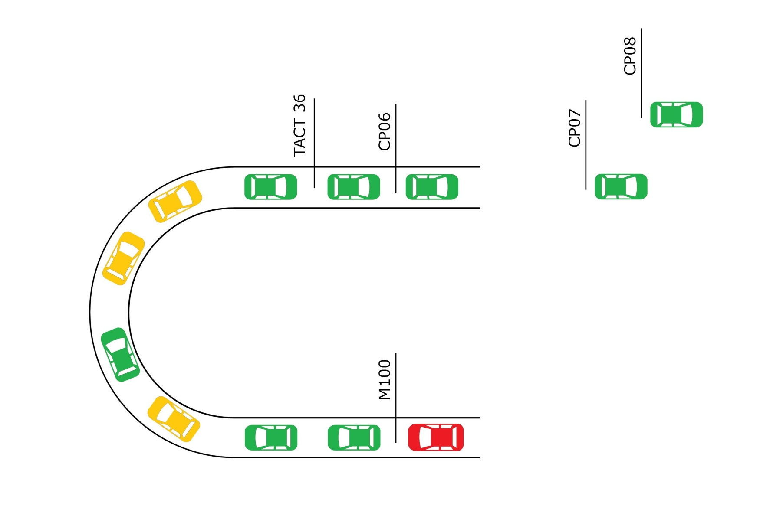



TRACEABILITY DISPLAY
Parking
Gate-3
Gate-4
Parking
UNPLANNED VEHICLE
Gate-2
Gate-1
SCHEDULED VEHICLE
BEHIND THE TIME

Slide 6
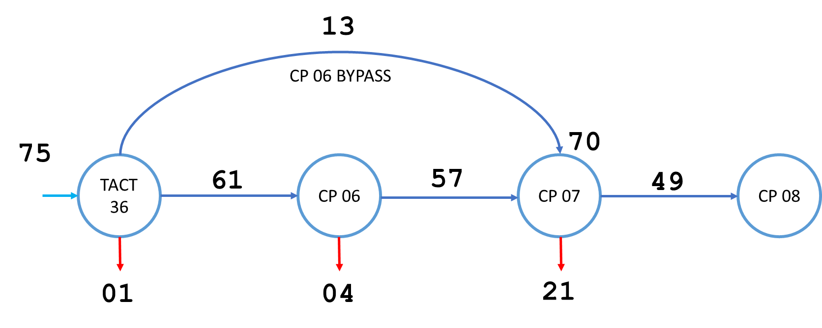
POINT TO POINT MAPPING
Gate-2 BYPASS
Gate-1
Gate-2
Gate-3
Gate-4

Slide 7
THANK YOU

